Slide 1

Recognising Random
Recognition of Random Processes from Simulated Auditory Experiences
Amy Renelle
Stephanie Budgett
Rhys Jones

Slide 2

Hello!
Amy Renelle
University of Auckland, New Zealand
amy.renelle@auckland.ac.nz

Slide 3
Introduction
If you’re happy and you know it, clap your hands.
If you’re happy and you know it, clap your hands.
Challenging student perceptions through auditory cues may provide a different way for connections between concepts to be understood.

Slide 4
Background
Using digital technology and multisensory learning to provide new experiences for students to develop their understanding.
So, HTHTH cannot be random.
Expecting this to play by the same rules.

Slide 5

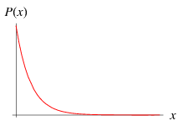
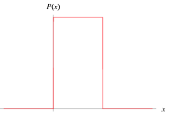
An Exercise
Notes:
Weisstein, Eric W. "Exponential Distribution." From MathWorld--A Wolfram Web Resource. http://mathworld.wolfram.com/ExponentialDistribution.html
Weisstein, Eric W. "Uniform Distribution." From MathWorld--A Wolfram Web Resource. http://mathworld.wolfram.com/UniformDistribution.html

Slide 6
The Study
2 Participants
First-Year University
Think-aloud Protocol

Slide 7
The Tool
The Scampy Tool
Video Mode – Data Mode – Simulation Mode

Slide 8
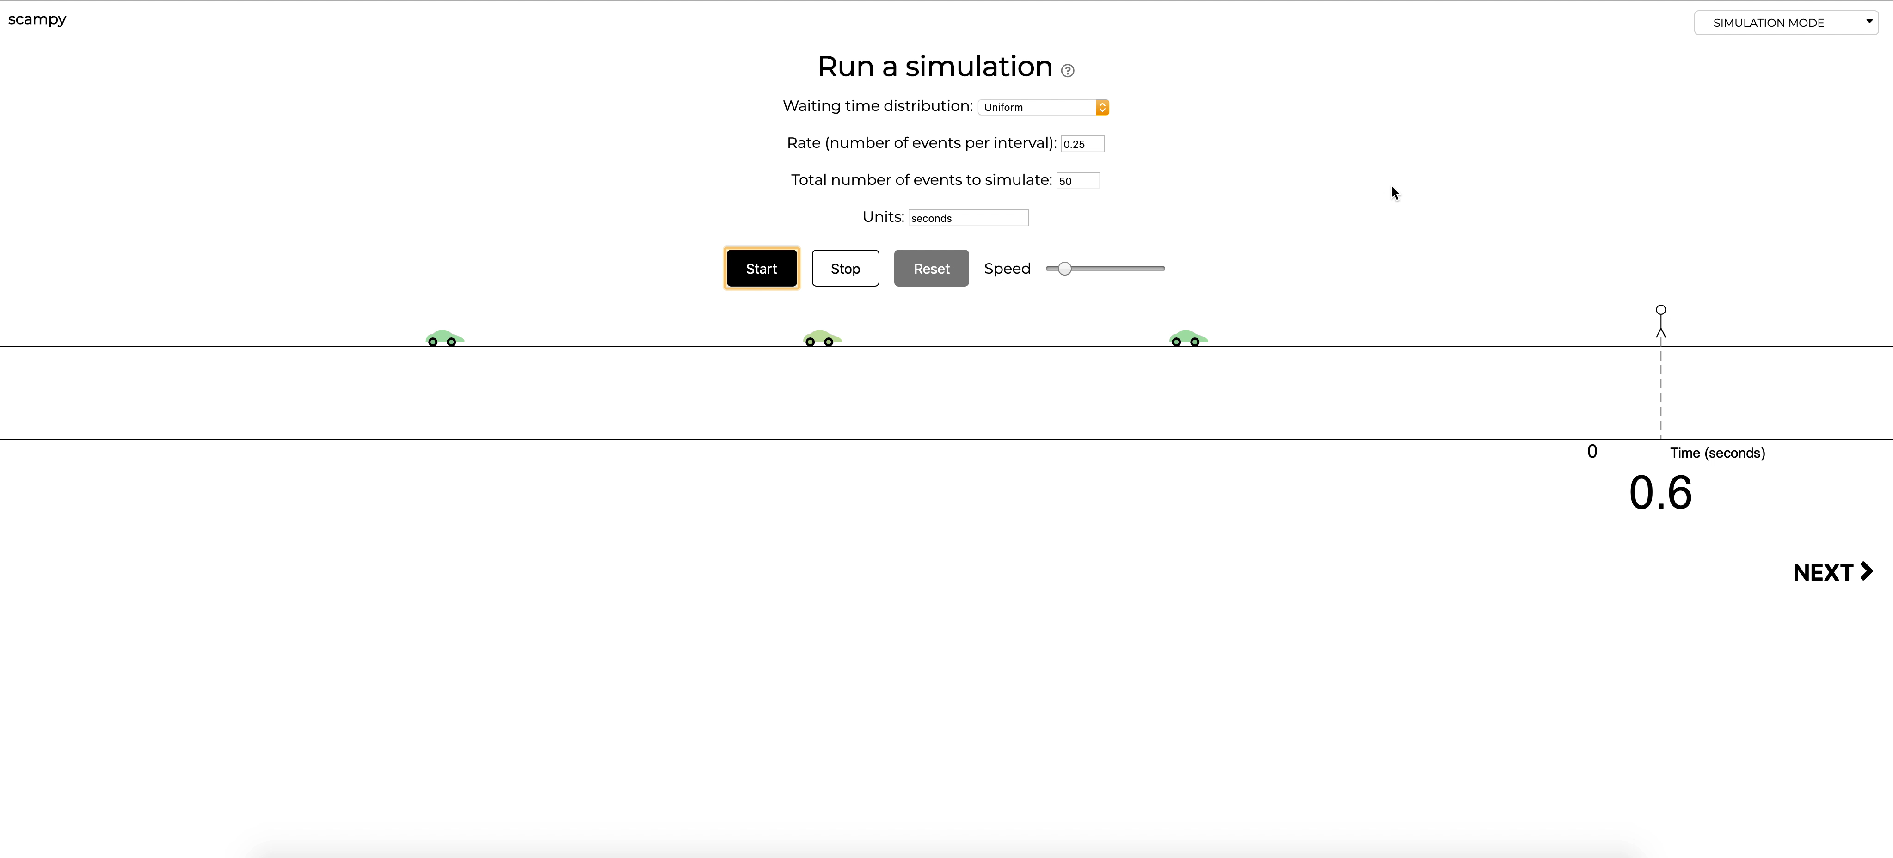

Slide 9
The Task
Conjecture
Observe Simulation
Consider Sounds
Compare to Expectations
Repeat Simulation with Constant Waiting Times

Slide 10
The Responses
Conjecture
Observe
Sounds
Compare
Repeat
We used the tool as a platform for investigating participant perspectives of randomness through auditory cues.
P1: The waiting time is the same.
Res: Why, why are you saying that it didn’t sound uniform?
P1: Oh because if it’s uniform it’s kind of obvious, it’s like a beat of a metronome, 1, 2, 3, 4.
Res: Just wondering about the sounds, with the beeps, did it sound uniform?
P1: Nope.

Slide 11
Discussion
Challenge student misconceptions? Classroom implementation?
…yet to be established.
Is the use of Auditory Cues beneficial for learning?
Has anyone tried this before?
Does the use of senses cause Cognitive Overload?
What would a correct response be?
Should students have known what to expect from the simulation?

Slide 12
Thank You.
Questions?
Amy Renelle
University of Auckland, New Zealand
amy.renelle@auckland.ac.nz

